Slide 1
Using APEX Oracle

Slide 2
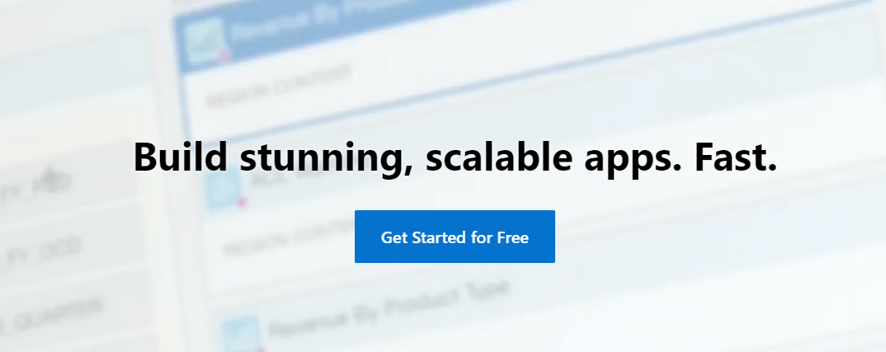
Go to the site and click get started for free
https://apex.oracle.com/en/

Slide 3
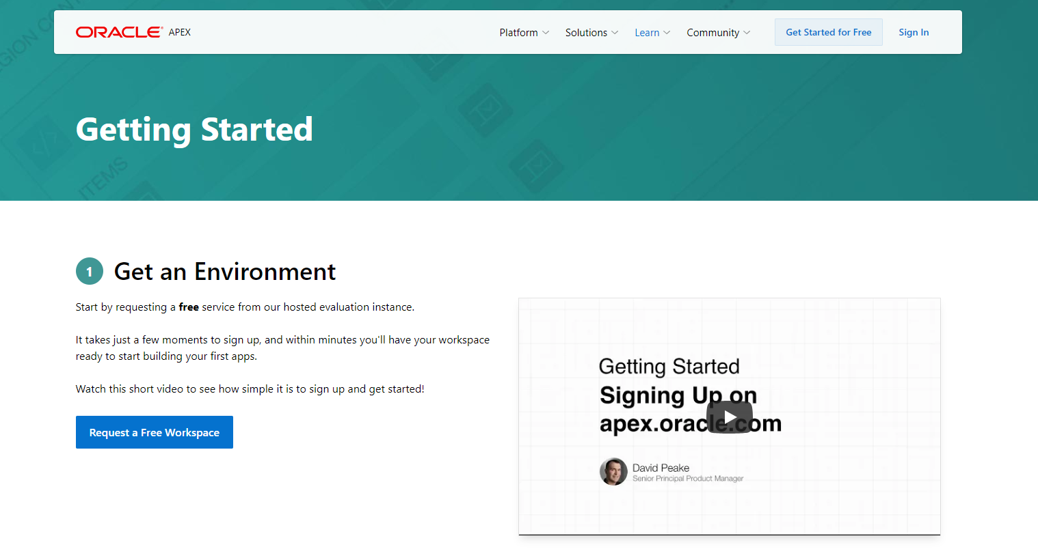
Click Request a Free Workspace

Slide 4
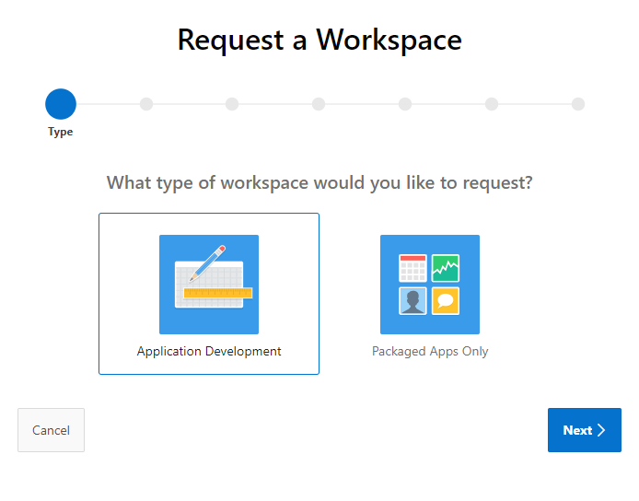
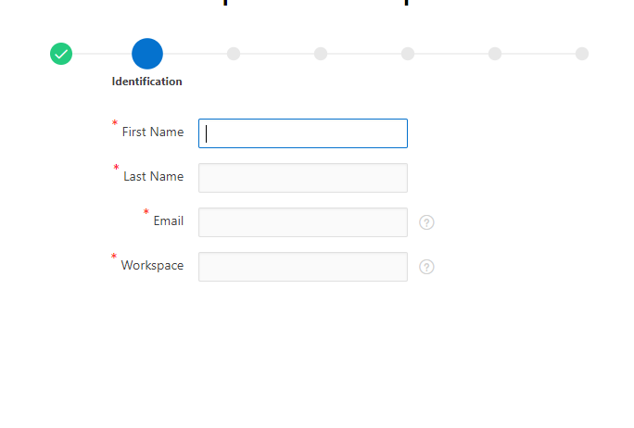
Click Application Development
Click Application Development
Enter your credentials and a name for your workspace

Slide 5
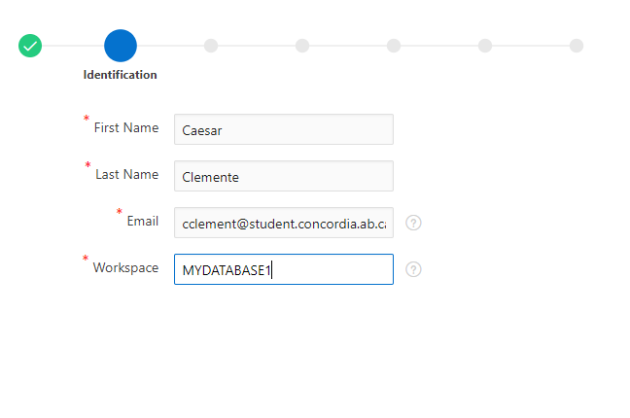
Sample

Slide 6
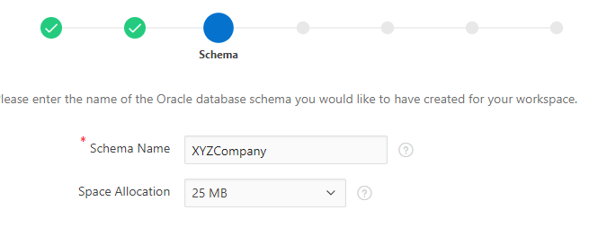
Choose a schema name

Slide 7
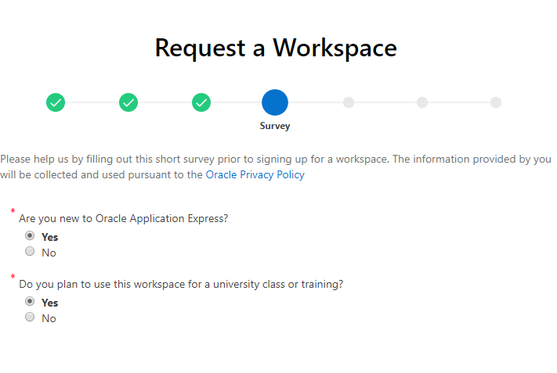
Answer yes to the survey

Slide 8
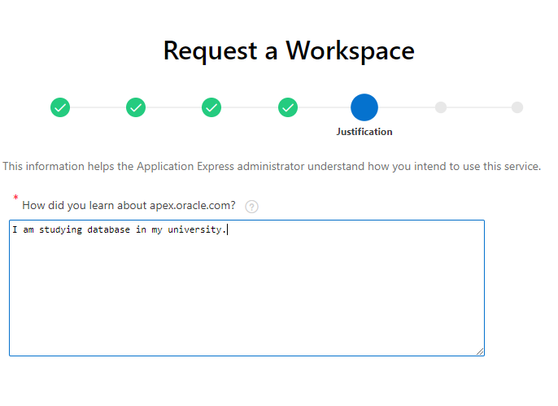
Provide a justification

Slide 9
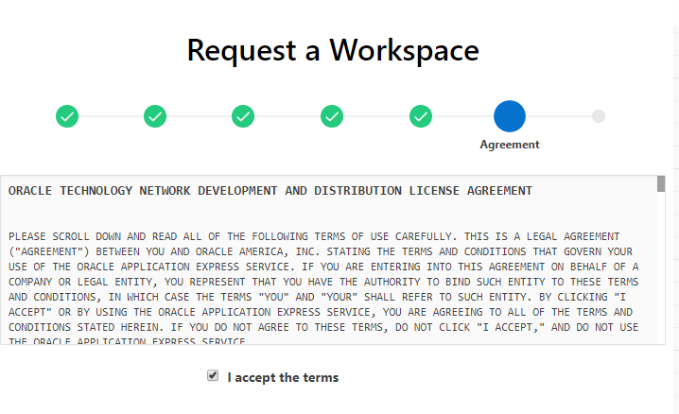
Accept the terms

Slide 10
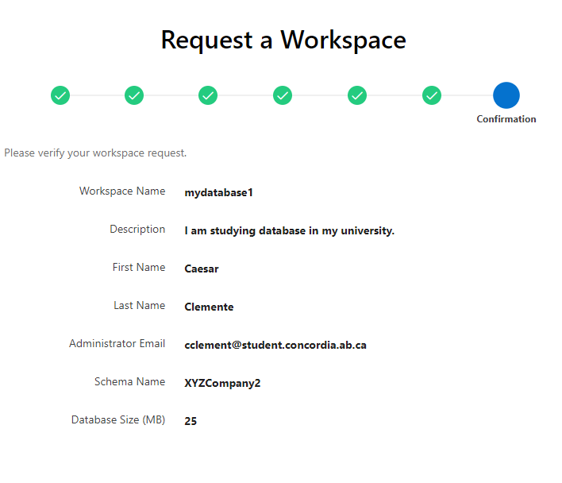
Submit Request

Slide 11
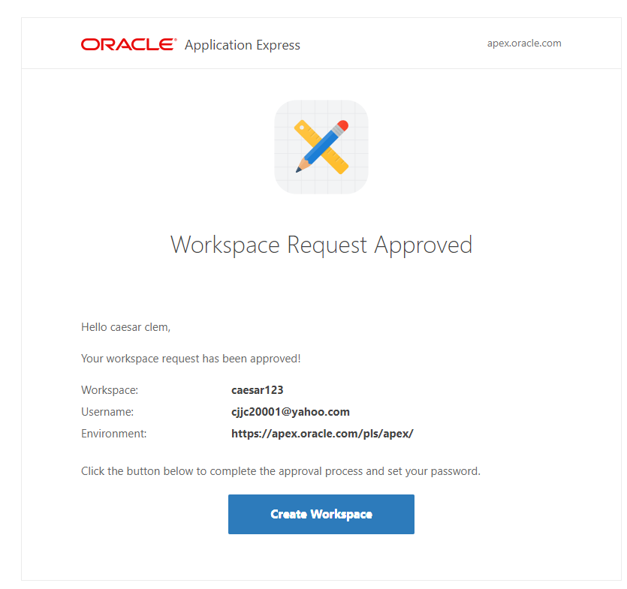
Open your email and create the workspace and provide a password

Slide 12
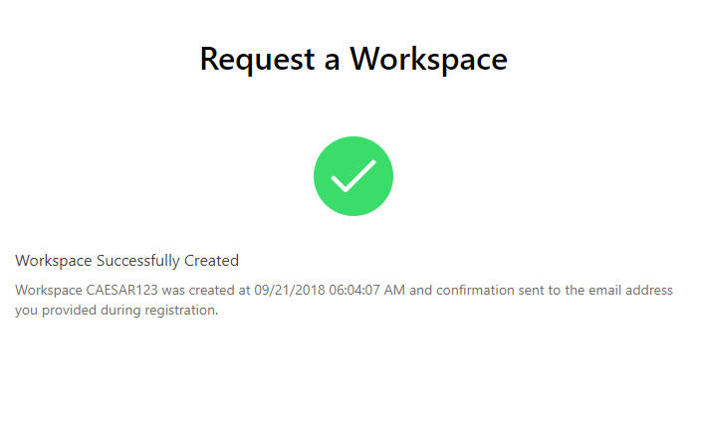
If you are successful the following will be displayed. You can now proceed to logging in

Slide 13
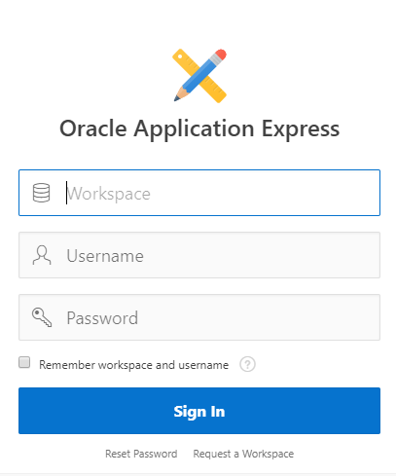
Log in

Slide 14
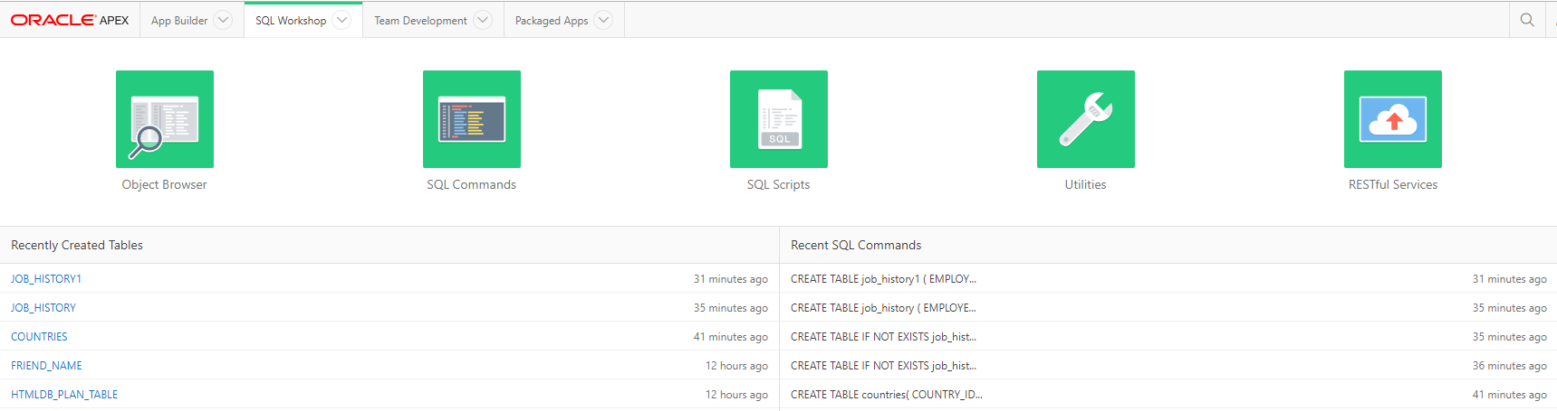
You can now begin using Oracle APEX

